Slide 1
Understanding RESTful services
Madhu Venkat
Guest Faculty
BITS, WILP

Slide 2
REST Web Services
Architectural Style
Utilizes web standards
Stateless communication protocol
Standardized interface and protocol

Slide 3
Advantages of Web services
Resource Identification – Data and functionality are considered resources.
Uniform interfaces – Resources are manipulated using a fixed set of operations (GET, PUT, DELETE, POST)
Self Descriptive – A resource can be represented in multiple formats.
Stateful interaction – Communication between the client and the endpoint is stateless.

Slide 4
JAX-RS Specification
Set of Interfaces and annotations
Implementation of specification

Slide 5
JSON Methods
HTTP GET
HTTP POST
HTTP PUT
HTTP DELETE

Slide 6
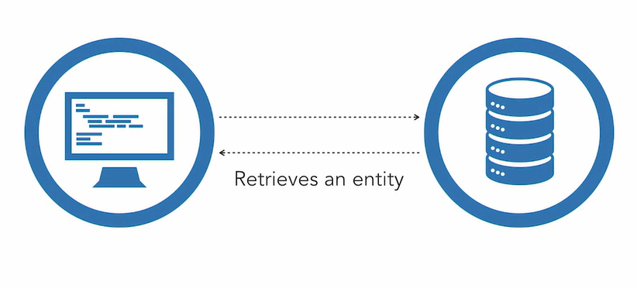
HTTP GET Resource

Slide 7
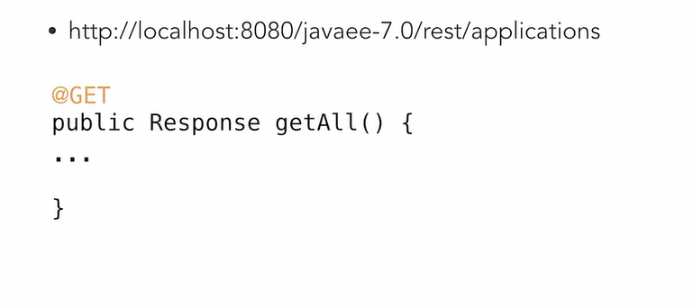
HTTP GET Resource - Example

Slide 8
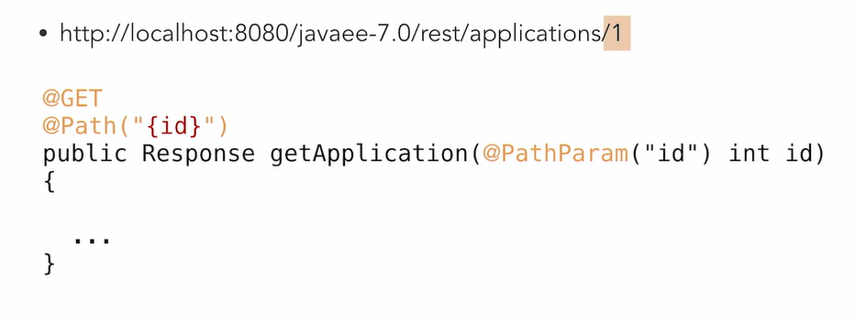
GET Resource with parameter

Slide 9
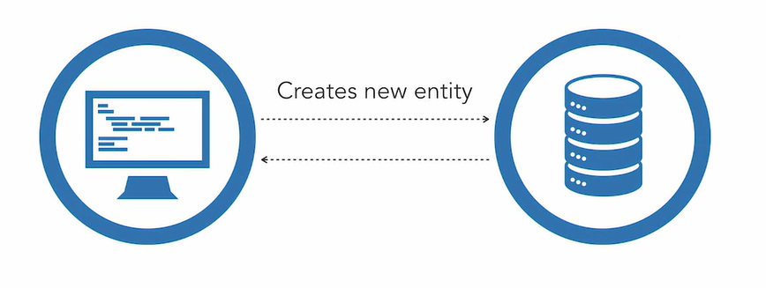
HTTP Post

Slide 10
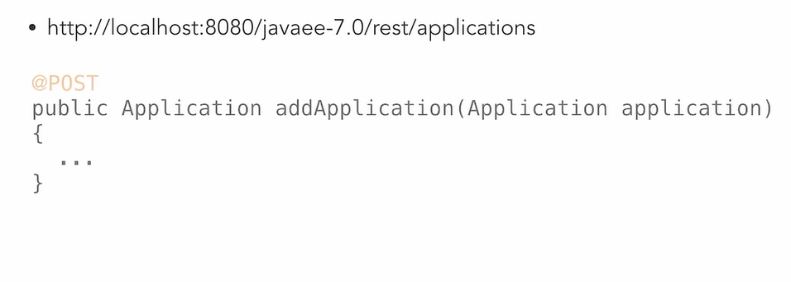
POST Request

Slide 11
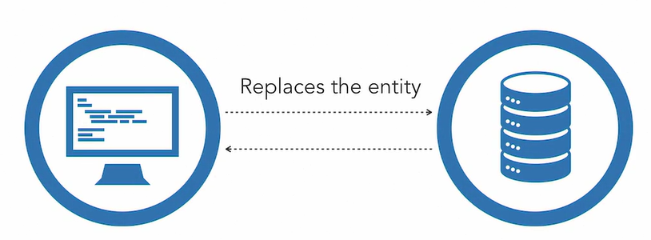
HTTP PUT Resource

Slide 12
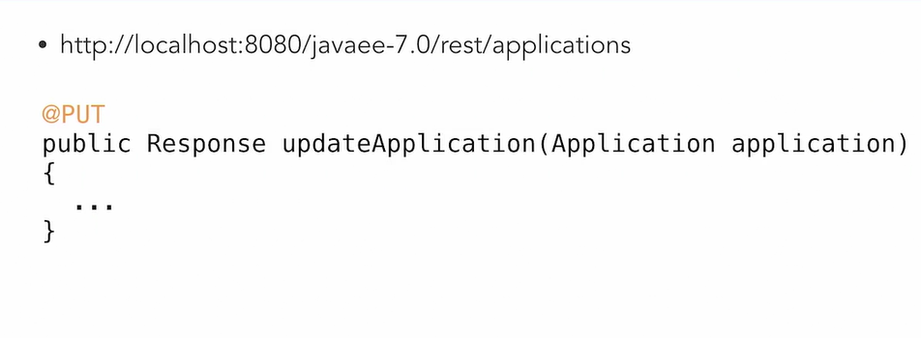
HTTP PUT Resource - Example

Slide 13
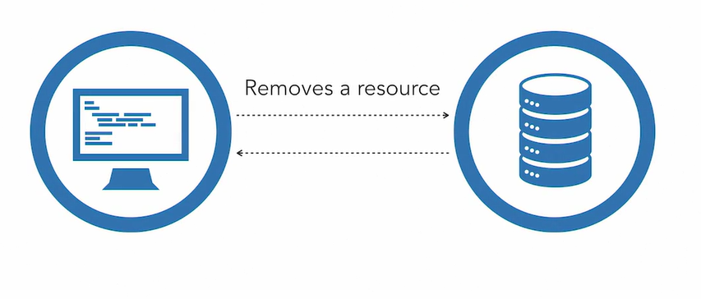
HTTP DELETE Resource

Slide 14
HTTP DELETE Resource - Example

Slide 15
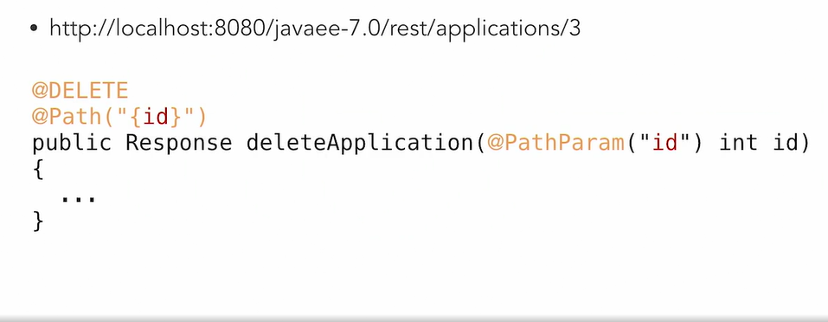
HTTP Delete Resource - Example

